Slide 1
Chapter 5
Section 5.1

Slide 2

Introduction to Arrays
An array is used to process a collection of data of the same type
Examples: A list of names A list of temperatures
Why do we need arrays?
Imagine keeping track of 5 test scores, or 100, or 1000 in memory
How would you name all the variables?
How would you process each of the variables?

Slide 3
Chapter 5
Section 5.2

Slide 4
Declaring an Array
An array, named score, containing five variables of type int can be declared as
int score[ 5 ];
This is like declaring 5 variables of type int:
score[0], score[1], … , score[4]
The value in brackets is called
A subscript
An index

Slide 5
The Array Variables
The variables making up the array are referred to as
Indexed variables
Subscripted variables
Elements of the array
The number of indexed variables in an array is the declared size, or size, of the array
The largest index is one less than the size
The first index value is zero

Slide 6
Array Variable Types
An array can have indexed variables of any type
All indexed variables in an array are of the same type
This is the base type of the array
An indexed variable can be used anywhere an ordinary variable of the base type is used

Slide 7
Using [ ] With Arrays
In an array declaration, the [ ]'s enclose the size of the array such as this array of 5 integers:
int score [5];
When referring to one of the indexed variables, the [ ]'s enclose a number identifying one of the indexed variables
score[3] is one of the indexed variables
The value in the [ ]'s can be any expression that evaluates to one of the integers 0 to (size -1)

Slide 8
Assigning values to an array
An array element is equivalent to a variable of the same data type
You can assign any data of an appropriate type to an array element
For example,
int array[5]; //an array of 5 integers
array[0]=10; //assign integer value to each array element
array[1]=20;
array[2]=30;
array[3]=40;
array[4]=50;

Slide 9
Using expressions for index
Any expressions that returns an integer can be used an index
For example,
int score[5];
int n=0;
score[n+1]=25;

Slide 10
Initializing Arrays
To initialize an array when it is declared
The values for the indexed variables are enclosed in braces and separated by commas
Example:
int children[3] = { 2, 12, 1 };
Is equivalent to:
int children[3]; children[0] = 2; children[1] = 12; children[2] = 1;

Slide 11
Default Values
If too few values are listed in an initialization statement
The listed values are used to initialize the first of the indexed variables
The remaining indexed variables are initialized to a zero of the base type
Example:
int a[10] = {5, 5};
Initializes a[0] and a[1] to 5 and a[2] through a[9] to 0

Slide 12
Chapter 5
Sections 5.3-5.4

Slide 13
Loops and Arrays
for loops are commonly used to step through (or process) arrays
Example:
for (i = 0; i < 5; i++) { cout << score[i] << endl; }
Displays the score stored in an array
first index is 0
last index is (size – 1)

Slide 14
Constants and Arrays
Use constants to declare the size of an array
Using a constant allows your code to be easily altered for use on a smaller or larger set of data
Example:
const int NUMBER_OF_STUDENTS = 50; int score[NUMBER_OF_STUDENTS]; … for ( i = 0; i < NUMBER_OF_STUDENTS; i++)
{
cout << score[i] << endl;
}
Only the value of the constant must be changed to make this code work for any number of students

Slide 15
Array Index Out of Range
A common error is using a nonexistent index
Index values for int a[6] are the values 0 through 5
An index value not allowed by the array declaration is out of range
Using an out of range index value may or may not produce an error message!

Slide 16
Out of Range Problems
If an array is declared as: int a[6]; and an integer is declared as: int i = 7;
Executing the statement a[i] = 238; causes…
The computer to calculate the address of the illegal a[7]
This address could be where some other variable is stored
The value 238 is stored at the address calculated for a[7]
No warning is given!
A core dump may occur if the memory does not align with being able to write an integer at this location, such as an object (a string?)

Slide 17
Uninitialized Arrays
If no values are listed in the array declaration, some compilers will initialize each variable to a zero of the base type
DO NOT DEPEND ON THIS!
Our Linux compiler DOES NOT DO THIS. If no values are listed, it will leave the array elements as uninitialized!

Slide 18
Chapter 5
Section 5.5

Slide 19
Multiple Arrays
Common to have multiple related arrays in a program
Check demo program for an example

Slide 20
Chapter 5
Section 5.6

Slide 21
Swapping variables
Swapping two variables x and y means to assign y's value to x, and x's value to y.
Usually a third temporary variable is needed
Check the demo program on how to swap variables

Slide 22
Chapter 5
Section 5.7

Slide 23
Modifying array elements
Use a loop to iterate through the array
Inside the loop, access element of the array, one at time
Make the required changes

Slide 24
Copying array elements
To copy an array, you need an destination array that can fit the source array
Iterate through the source array in a loop, one element at a time and assign the source array value to the corresponding destination array element

Slide 25
Chapter 5
Section 5.8

Slide 26
Reversing an array
Inside a loop, swap between first and last elements, second and second-to-last elements, third and third-to-last elements, and so on.
Another strategy: copy the array starting from the last element and decrement the loop counter by 1 until you get to the first element
This method wastes memory

Slide 27
Chapter 5
Section 5.9

Slide 28
Multi-Dimensional Arrays
C++ allows arrays with multiple index values
char page [30] [100];
declares an array of characters named page
page has two index values:
The first ranges from 0 to 29
The second ranges from 0 to 99
Each index is enclosed in its own brackets
Page can be visualized as an array of 30 rows and 100 columns

Slide 29
Index Values of page
The indexed variables for array page are
page[0][0], page[0][1], …, page[0][99] page[1][0], page[1][1], …, page[1][99]
…
page[29][0], page[29][1], … , page[29][99]
page is actually an array of size 30
page's base type is an array of 100 characters

Slide 30
Chapter 5
Section 5.10

Slide 31
An Array Type for Strings
C-strings can be used to represent strings of characters
C-strings are stored as arrays of characters
C-strings use the null character '\0' to end a string
The Null character is a single character
To declare a C-string variable, declare an array of characters:
char s[11];

Slide 32
C-String Details
Declaring a C-string as char s[10] creates space for only nine characters
The null character terminator requires one space
A C-string variable does not need a size variable
The null character '\0' immediately follows the last character of the string
Example:
s[0] | s[1] | s[2] | s[3] | s[4] | s[5] | s[6] | s[7] | s[8] | s[9]
H | i |  | M | o | m | ! | \0 | ? | ?

Slide 33
C-String Declaration
To declare a C-string variable, use the syntax: char Array_name[ Maximum_C_String_Size + 1];
The +1 reserves the additional character needed by '\0'

Slide 34
Initializing a C-String
To initialize a C-string during declaration:
char my_message[20] = "Hi there.";
The null character '\0' is added for you
Another alternative: char short_string[ ] = "abc";
But not this: char short_string[ ] = {'a', 'b', 'c'};
This attempt to initialize a C-string does not cause the '\0' to be inserted in the array

Slide 35
Don’t Change '\0'
Do not replace the null character when manipulating indexed variables in a C-string
If the null character is lost, the array cannot act like a C-string
Example: int index = 0; while (our_string[index] != '\0') { our_string[index] = 'X'; index++; }
This code depends on finding the null character!

Slide 36
C-Strings Output
C-strings can be output with the insertion operator
Example:
char news[ ] = "C-strings"; cout << news << " Wow." << endl;

Slide 37
C-Strings Input
The extraction operator >> can fill a C-string
Whitespace ends reading of data
Example: char a[80], b[80]; cout << "Enter input: " << endl; cin >> a >> b; cout << a << b << "End of Output"; could produce: Enter input: Do be do to you! DobeEnd of Output

Slide 38
Reading an Entire Line
Predefined member function getline can read an entire line, including spaces
getline is a member of all input streams
getline has two arguments
The first is a C-string variable to receive input
The second is an integer, usually the size of the first argument specifying the maximum number of elements in the first argument getline is allowed to fill

Slide 39
Using getline
The following code is used to read an entire line including spaces into a single C-string variable
char a[80]; cout << "Enter input:\n"; cin.getline(a, 80); cout << a << "End Of Output\n";
and could produce: Enter some input: Do be do to you! Do be do to you!End of Output

Slide 40
getline Wrap Up
getline stops reading when the number of characters, less one, specified in the second argument have been placed in the C-string
One character is reserved for the null character
getline stops even if the end of the line has not been reached

Slide 41
getline Syntax for C-Strings
Syntax for using getline is
cin.getline(C_String_Var, Max_Chars + 1);
cin can be replaced by any input stream
Max_Chars + 1 reserves one element for the null character

Slide 42
C-String to Numbers
"1234" is a string of characters
1234 is a number
When doing numeric input, it is useful to read input as a string of characters, then convert the C-string to a number
Reading money may involve a dollar sign
Reading percentages may involve a percent sign

Slide 43
C-String to Integers
To read an integer as characters
Read input as characters into a C-string, removing unwanted characters
Use the predefined function atoi to convert the C-string to an int value
Example:
atoi("1234") returns the integer 1234
atoi("#123") returns 0 because # is not a digit

Slide 44
C-String to long/double
Larger integers can be converted using the pre-defined function atol
atol returns a value of type long
C-strings can be converted to type double using the predefined function atof
atof returns a value of type double
Example:
atof("9.99") returns 9.99
atof("$9.99") returns 0.0 because $ is not a digit

Slide 45
Library cstdlib
The conversion functions atoi atol atof are found in the library cstdlib
To use the functions use the include directive #include <cstdlib>

Slide 46
Chapter 5
Section 5.11-5.12

Slide 47
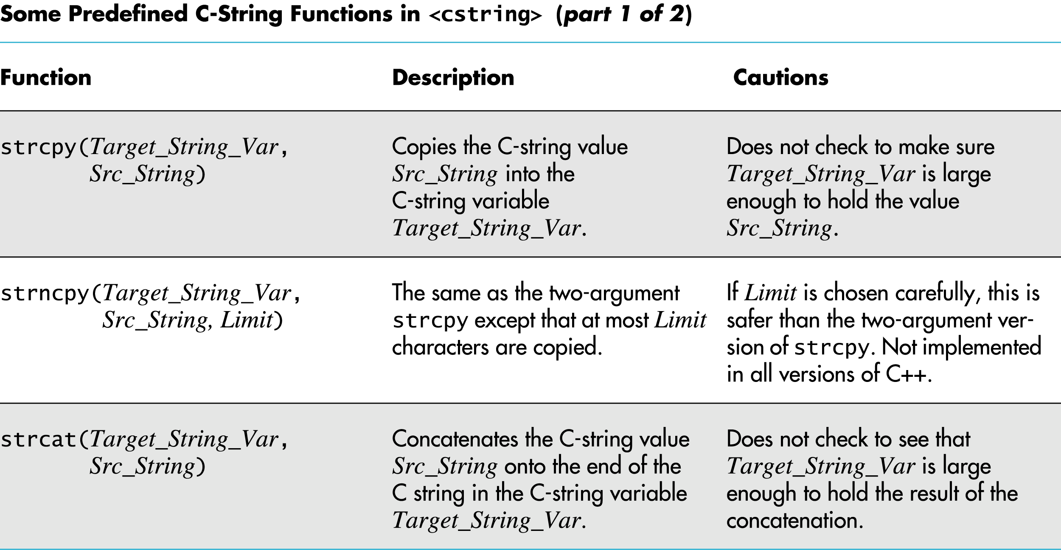
C-String Functions

Slide 48
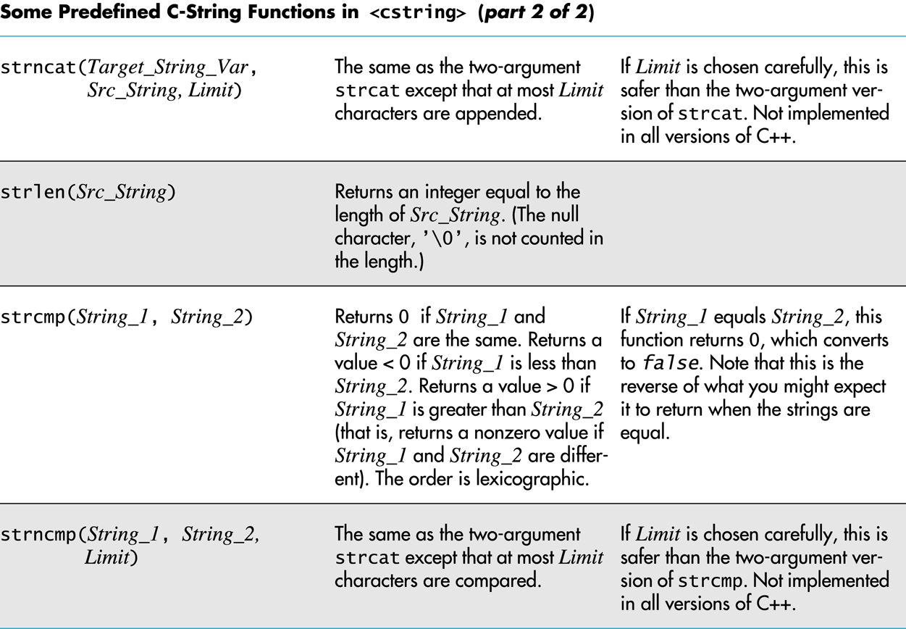
C-String Functions

Slide 49
C-String Functions
Character functions covered in Chapter 3.11

Slide 50
Chapter 5
Section 5.13

Slide 51
Arrays and Strings
C-Strings are basically arrays of strings
A 2-D array of characters gives us an array of strings

